Slide 1
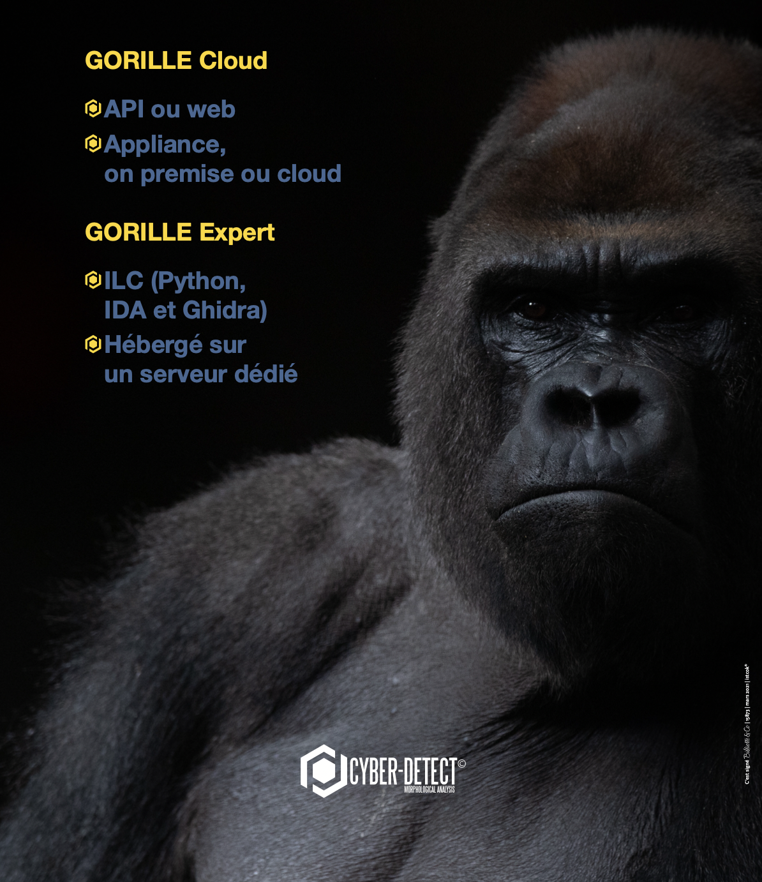
GORILLE
ANTIVIRUS FOR UNKNOWN THREATS
A countermeasure to protect your IT systems

Slide 2
RISKS & CONSEQUENCES
  Scenario
  Technical consequences
  Legal consequences
  Financial consequences
LIMITATIONS OF CLASSIC ANTIVIRUS
  Protection of the virus codes
  Weakness of behavior analysis
KEY ADVANTAGES OF GORILLE
  GORILLE technology
  Morphological Analysis
  Demo : classic & dynamic analysis
AGENDA

Slide 3
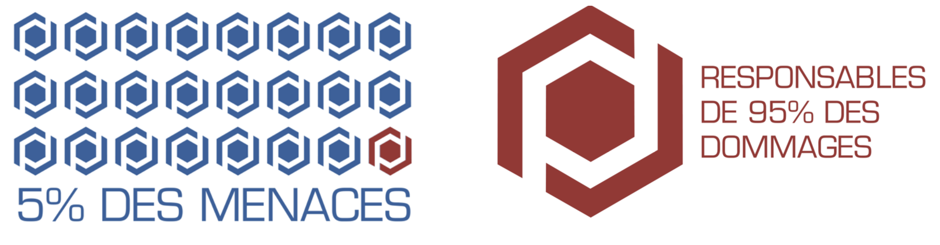
THE REAL THREAT :
THE REMAINING UNDETECTED VIRUS !
The virus do slip through the cracks of anti-virus… always late
ACCOUNTABLE
OF 95% OF
DAMAGES
5% OF THREATS
What are the damages and residual risks according to the protection levels ?

Slide 4
CONTEXT
TODAY, ANTIVIRUS ARE BASED ON
SIGNATURES ANALYSIS AND
BEHAVIOR ANALYSIS

Slide 5

THE PROTECTION OF VIRUS CODES
The detection of virus strains is very difficult because of malware code protection
Obfuscation
Cryptography
Auto-modification
Protection againt anti-analysis measures
Notes:
Why is it so difficult (or impossible) for classic antivirus to detect and identify new variant/mutant of existing virus ? The main anti-malware analyzer are :
Obfuscation
Encryption
Auto-modification
Anti-debugger

Slide 6
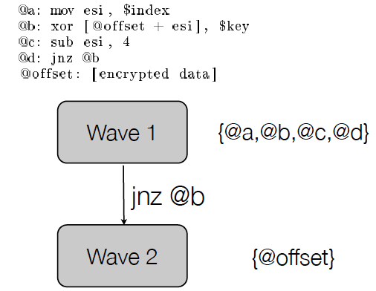
AUTO-MODIFICATIONS
A loop of decryption
Notes:
Some virus encrypt the codes. They unencrypt the code, wave by wave. At each wave, the virus is self-modifying its own code and check if the previous phase is changed or not (by analyzer).

Slide 7
PROTECTION AGAINST ANTI-MALWARES ANALYSIS
MOV EAX,-1
INT 2E
CMP WORD PTR DS:[EDX-2],2ECD
If the virus code detects a virtual machine, it will execute some other operations
2E interrupt with an invalid EAX register
Normal behavior: EDX contains the following instruction address
We test if EDX-2 points to the opcode of INT 2E, here 2ECD
If the program is supervised, EDX contains 0xFFFFFF

Slide 8
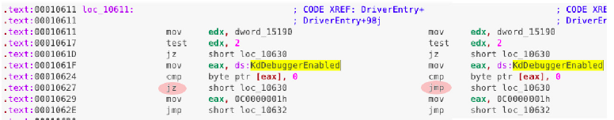
PROTECTIONS AGAINST ANTI-MALWARE ANALYSIS
If the virus code detects a debogger, it will execute some other benign operations
DRIVER OF DUQU (which descends from STUXNET)
Duqu search to steal data. This virus was running more than decade before being detected
Notes:
Here, a test is executed by the virus to detect the presence of a Debugger, if so, the virus run a jump operation to run another benign code

Slide 9
THE WEAKNESS OF BEHAVIOR ANALYSIS
A GENERAL PANORAMA

Slide 10
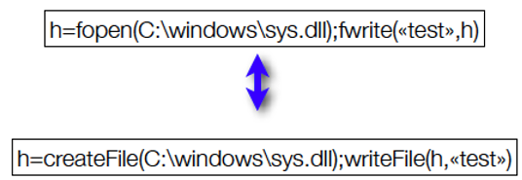
BEHAVIOR ANALYSIS IS UNSUFFICIENT
Course of action identification. System calls, Library calls, interaction with the network, etc.
2 approaches
  Detection of anomaly vs normal regular behavior
  Detection from abnormal behavior
CONS
  Hard to say what is legitimate or not
  Hard to maintain in practices
  Features obfuscation
Here are 2 different ways to write in a file :

Slide 11
FULL IA ENGINE WEAKNESSES
IA finds similarity by doesn’t qualify (not a formal method). Needs many clients to exploit numerous and heterogenous data
IA learns existing and known malware (which consistent data set to use ?)
Not reproducible by definition
Not a comprehensive tool to deeply help attack
Need much more human resources. On contrary of spam (for example) there is no human to classify for no automatic detected ones
Sensitive to report layout.
In case of crises to many data to manage by expert, analyst, etc. To few automation
Sensitive to attacker manipulation
Notes:
In this bench test, none behavior based software was able to detect several virus submitted

Slide 12
MORPHOLOGICAL ANALYSIS
THE GORILLE TECHNOLOGY

Slide 13

A NEW APPROACH :
THE MORPHOLOGICAL ANALYSIS
Retro-engineering
Engineering
Notes:
Gorille acts as a malware detector
Gorille identifies unduly actions or suspicious on the operating system
Gorille acts as a reverse Engineering , automatic and intelligent
Here with Simpson-Omer, its evolution rises the complexity. Gorille .search the origin of the attack by revealing the nature, the chimpanzee

Slide 14
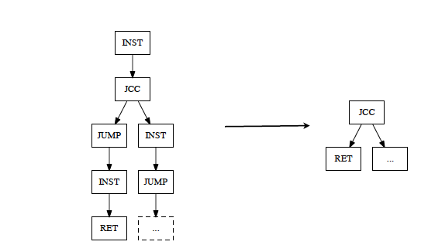
MORPHOLOGICAL ANALYSIS : THE CODE ABSTRACTION
An abstract view of the programs
Notes:
Morphological analysis is a unique technology used by the Gorille engine by formal method and Graph algoritmics .
Here a set of operations that are “simplified” to a reduced set of operations, called abstracted view

Slide 15
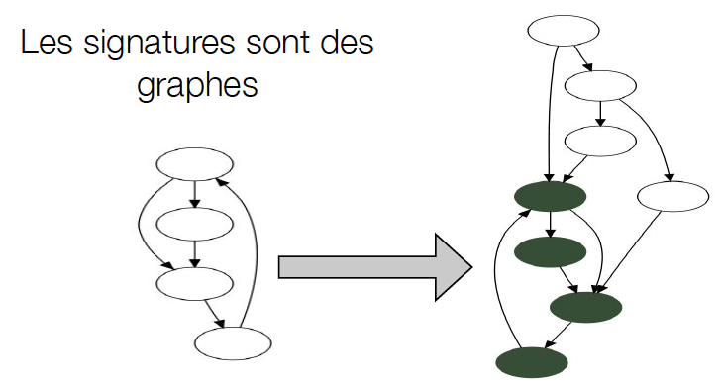
GORILLE =
MORPHOLOGICAL ANALYSIS
Objectives : detecting the presence of sites into the files
NOW, FOR GORILLE THE NEW SIGNATURE IS THE GRAPHS !
Notes:
A site is a set of code/operation describing/revealing a behavior : malicious or not. The analyzed file is divided in sites with formal method. Correlations between sites bring malicious behaviors proof.
Furthermore, a comparison is also performed between sites files and database sites.
The database is updated automatically

Slide 16
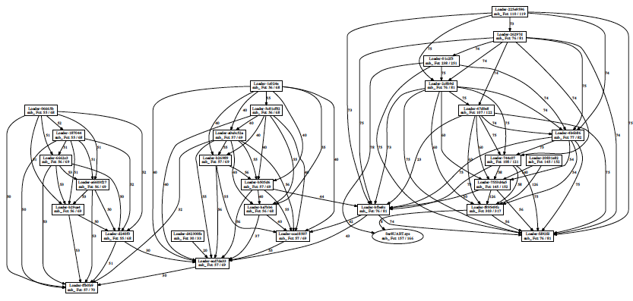
MALWARE FAMILY
With several samples of malware, GORILLE can set families by comparaison and « sites » search
REGIN
Notes:
With several samples of the same virus, Gorille is able to set families. This job is scriptable for automation families building

Slide 17
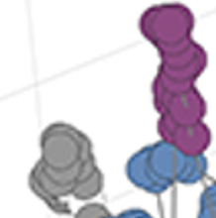
A NEW MALWARE SIGNATURE
Notes:
The aggregation of sites gives rise of a comprehensive abstracted 3D-Graph. This abstracted view represents now for Gorille the new malware « signature »

Slide 18
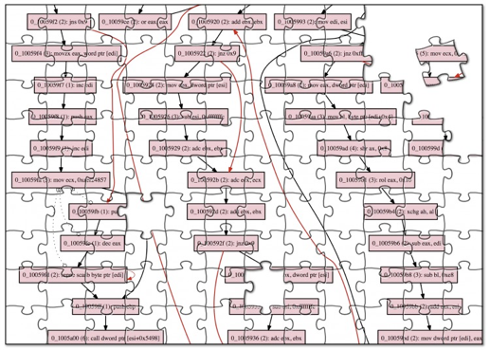
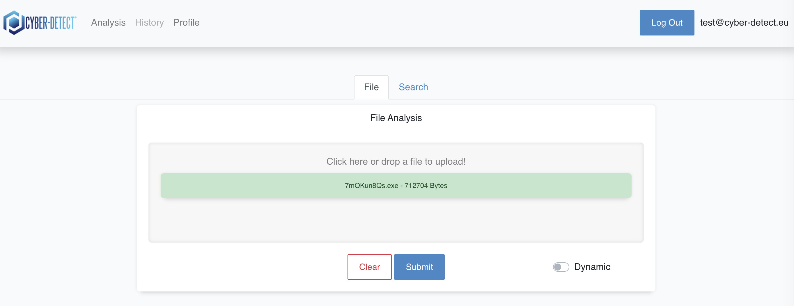
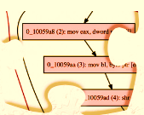
NOVEL APPROACH :
THE MORPHOLOGICAL IDENTIFICATION OF THE SUB CODE MALICIOUS (SITES)
A set of sites delineates the global behavior of a process/ file
Each site is a behavior
Corelation of sites triggers and alert
Avdanced Formal Methods
Graphs Algorithmics
Light-weight Machine-Learning
Notes:
At the first step, the static analysis consists of formal method analysis.
The binary file is cut by Gorille into pieces to extract several bricks (sites). Each site represents a elementary behavior (malicious or not)
The Gorille will correlate those elementary behaviors
When the group of elementary reveil a global malicious behavior, it triggers an alert. It brings the link with existing set of sites known by Gorille database
The AI enables Gorille to explorer several combination of sites. The AI updates the behavior database (either malicious or not). This feature avoid heavy and frequent database update
The analysis of files for building Graph Of Flow Control is performed by a formal method.
The graph is a view abstraction of real code.
Sites malicious behavior are revealed by Gorille engine. Correlation are done between sites, as well as between sites and Gorille database
Gorille uses 3 combined methods : :
A formal method.
Algorithms to build the 3D-graph
AI to explore automatically different combinations and correlation between sites.
GLOSSARY
SITE. A site is a set of operations (code), about 20 operation, reduced (abstract view)
A site defines an elementary malicious or not malicious behavior. The “sites” building is done by an automatic process
FALSE POSITIVE. A false positive is an error, it launches an alter where no malware is present
For classic AV there is no false positive, by definition
FALSE NEGATIVE. A false negative occurs when a virus is not launching an alert when a malware is really present
With classic antivirus, there is a lot of false negative because they cannot discover new mutant. In fact classic antivirus are very sensitive to protection such as :obfuscation, encryption, auto-modification and protection against antimalware detectors
VIRUS SIGNATURE. Classic AV detect the presence of a set of code already known by the AV editor.
The AV is just analyzing if this code exists or not
An antivirus can be used by a hacker to verify if his new virus will be recognized or not by the current AV of the market
The new virus author uses usually packer programs to change the signature from classic AV
CONTROL FLOW GRAPH (CFG). is a representation, using graph notation, of all paths that might be traversed through a program during its execution.
A set of sites aggregated. Those graphs are a new malware signature for Gorille
BEHAVIOR ANALYSIS METHOD. A detection based of the actions done by the virus : system calls, library call, actions with the network
Very difficult to say if a set of code is abnormal, suspicious or just a regular/normal/benign code. When the end-user is involved, how to decide if the code is legitimate ? Not very reliable !!
AUTO MODIFICATION. The auto modification is the new code written on the fly, by the malware, and executed, wave by wave. A phase of new code execution is called a wave. The payload is hidden until the last pre-defined phase is installing the payload. We can have many phases before the real payload is running
ANTI-ANALYSIS. It verifies the debugger or VM presence
MORPHOLOGICAL ANALYSIS. This is new and unique cyber-detect’s method for analyzing executable binary
Gorille software executes the malware and gets groups of “sites”
Gorille builds a CFG made with thoses sites. The CFG is a new virus signature for Gorille
GENERIC STRAIN. Gorille finds a infected file with a set of sites. “Generic” means, that the name of the virus is not known even if it really infects the current file. A later comparison with variant sample can bring the name of this malware
WAVE. A set of auto-modification code. It is automatically analyzed by Gorille and displayed

Slide 19

DYNAMIC ANALYSIS :
FULLY AUTOMATED OBFUSCATION MITIGATIONS
Wave 1
1005000 | pushfd
1005001 | push 0x3
1005003 | jae 0x1005010
1005005 | jmp 0x1005009
1005007 | db 0x75 ; 'u'
1005008 | db 0x75 ; 'u'
1005009 | call 0x1005014
100500e | xor ax, 0xf773
1005012 | jmp 0x1005031
1005014 | add esp, 0x4
1005017 | jmp 0x100501b
1005019 | db 0x75 ; 'u'
100501a | db 0x75 ; 'u'
100501b | dec dword
Wave 18
1006ba7 | mov ebx, dword ptr [ebp+0x403783]
1006bad | xor esi, esi
1006baf | not ebx
1006bb1 | or esi, ebx
1006bb3 | jnz 0xa
1006bbd | add ebx, dword ptr [ebp+0x403763]
Wave 2
1007088 | call 0x100708d
100708d | sub dword [ss:esp], 0x23a
1007094 | jmp dword [ss:esp+0x4]
decrypts
….
decrypts
decrypts
Packers
Anti-virtualization tricks
Obfuscation
Notes:
EMOTET is a hidden program inside a « normal » application, opensource, that everybody can download.
In DYNAMIC mode, the malware is running in a sandbox, in secure environment
For our sample here, at the 18th wave of self-modification, the carrier trigger the installation of the payload

Slide 20
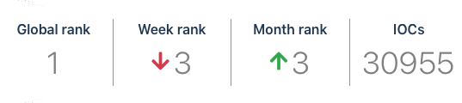
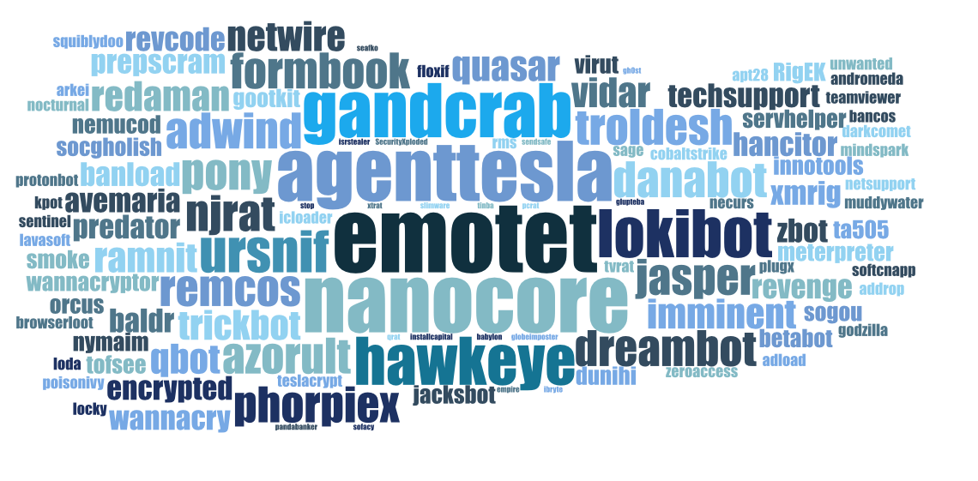
DANGEROUSNESS OF EMOTET #1
Emotet is one of the most dangerous trojans to have been created. Over the course of its lifetime, it was upgraded to become a very destructive malware. It targets mostly corporate victims but even private users get infected in mass spam email campaigns (any.run)
BANKING TROJAN
DOWNLOAD AND INSTALL PAYLOADS
https://www.cert.ssi.gouv.fr/alerte/CERTFR-2020-ALE-019/
Notes:
A demo with Emotet, a banking Trojan. It evolved through several protections. As a Trojan, It can carry several malware and install them
Emotet is an old and known malware (2014-2016), nevertheless, it is still operational when it keep stealthy by protections we met in the beginning of this presentation
Here is a screenshot of the website any.run which shows the dangerousness of Emotet. It is one of the most dangerous that has never been created
The virus, when running on an endpoint, downloads from internet (C&C) the payload then installs it locally.
Here is an alert from ANSSI (French National cybersecurity agency, authority and regulator) Confer to the link

Slide 21
DEMO WITH THE EMOTET MALWARE
https://demo.gorille.tech

Slide 22
EMOTET
Notes:
The user, simply drags and drops the file to be analyzed by Gorille (web interface) to a white station for example
Gorille may perform a single file analysis or a folder analysis.

Slide 23
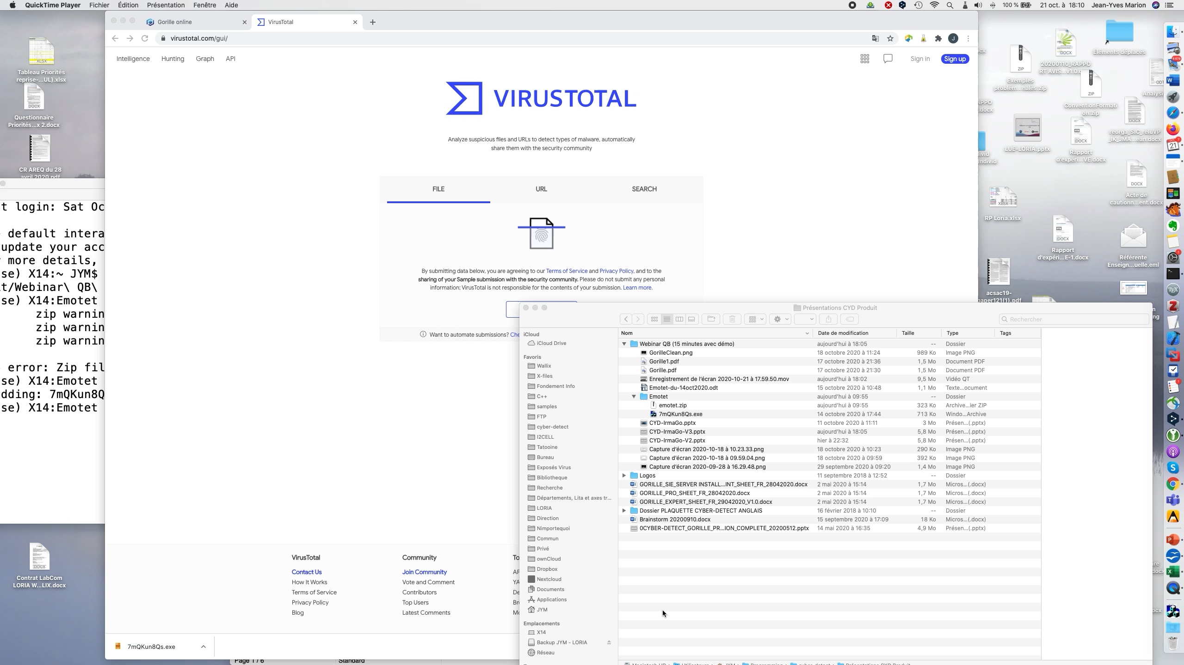
Notes:
The mutant version of virus are generally not recognized by the classic antivirus software.
Here the binary file of Emotet was submitted 3 days ago.
Among 60 AV engine embedded into the virustotal website, only 7 detected this version of Emotet
This version was detected by Gorille
When a new mutant is generated, most of time none antivirus detects it until it is captured and analyzed by AV editors for months. Then the file is shared between AV editors. Therefore, more and more AV signature database are updated. Therefore, the number of AV capable of detecting Emotet is raising everyday to reach 100% of AV, until the next modified Emotet generated by hackers
Here Gorille says Emotet is malicious malware only with the static analysis. It is very simple, then it uses the dynamic analysis more talkative.

Slide 24
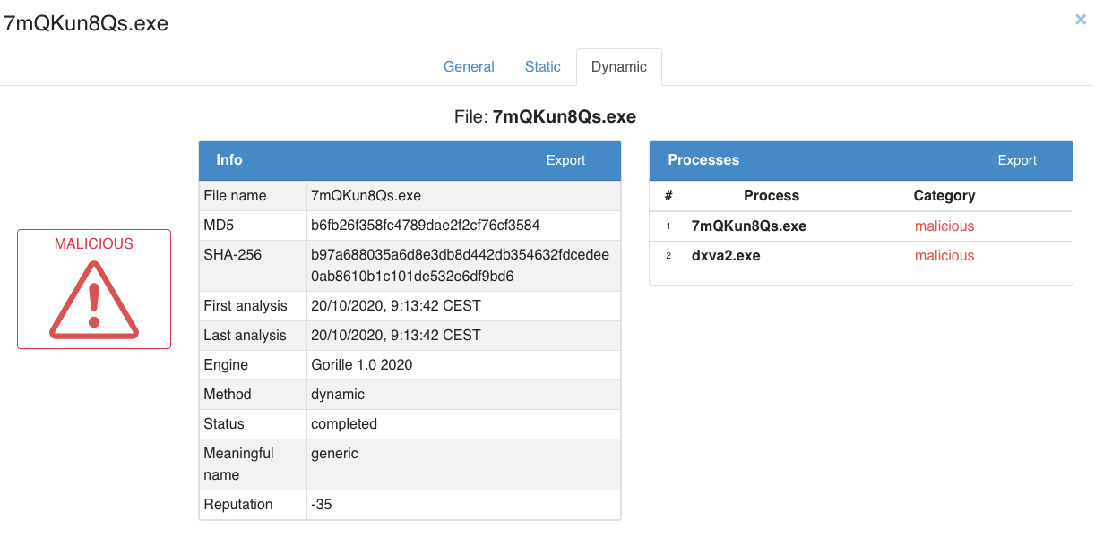
DYNAMIC ANALYSIS :
EMOTET #1
Robust & More precise
Notes:
1st screen displays the dynamic analysis outcomes
Reputation: -35 (very bad)

Slide 25
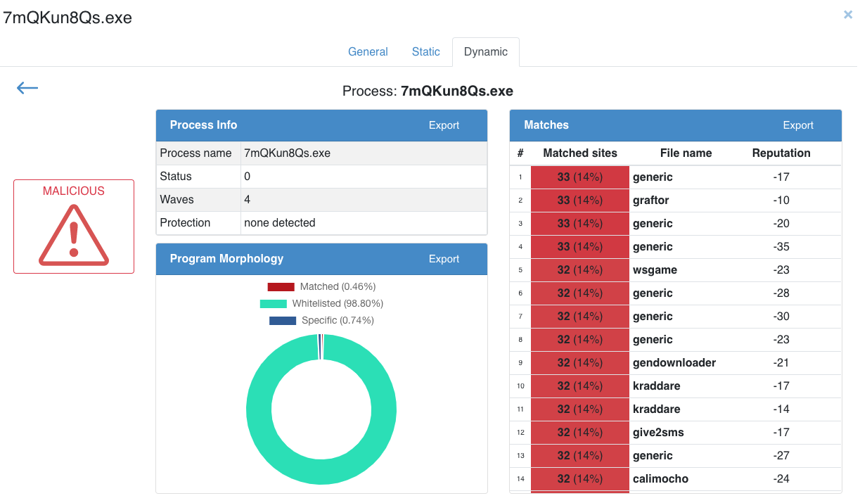
DYNAMIC ANALYSIS :
EMOTET #2
Notes:
Second screen of dynamic analysis outcomes
Here we have 4 waves of self-modification before the malware drop the payload on the host
Generic: unknown strain (but real strain)
The detected sites are performed with the gorille database sites

Slide 26
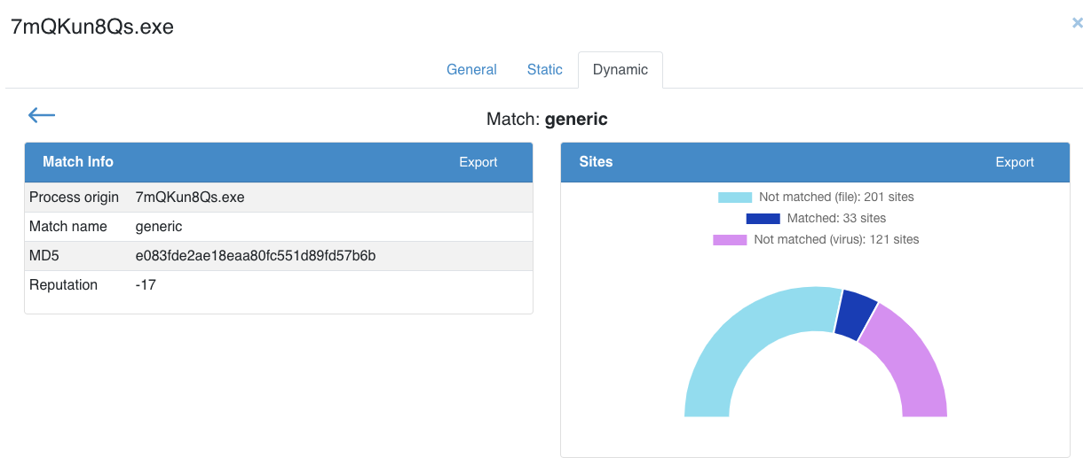
DYNAMIC ANALYSIS :
EMOTET #3
Notes:
Number of sites matched
Here we have 33 malicious sites detected
121 sites not detected for the sites of the virus
201 sites not matched

Slide 27
GORILLE REST API
# Upload file
curl --request POST \
--url https://demo.gorille.tech:4433/api/v1/files \
--header 'x-apikey: w6b8ly7oiktxxxxxxxxxptr882qwtgxbpawpndweglz1hlh5kv' \
--form file=@/Users/JYM/Programming/cyber-detect/FTP/samples/VIRUScX7hQTy7Py.EMOTET.bin
# Get analysis
curl --request GET \
--url https://demo.gorille.tech:4433/api/v1/files/{3c889d95e7a9398782bddc86157466bc} \
--header 'x-apikey: w6b8ly7oxxxxxxxxxxxxxxxxxxxxpawpndweglz1hlh5kv’ \
GORILLE offer a REST API, to foster the integration within an orchestrator or XDR solutions and more to come :
Compliant with VirusTotal API V3
https://demo.gorille.tech/api/index.html
Notes:
API is compliant with virustotal. No need to learn another language

Slide 28











IN NUTSHELL, WHY USING GORILLE ?
Low overhead
Anti-Virus
Gorille
Improve the user-experience with a fine granularity analysis
Fully automatable, fast and automatizable
Easily deployed, script via Rest API
Low risks reduction
Reduced risks
White list
High overhead
28
Notes:
Graph 2 axis: Risk reduction vs resources deployed
The classic AV are easy to install on an EndPoint but remain insufficient to reduce risks
The white-List. List of authorized application is very difficult to set and maintain. In the white-List of infected files hidden like opensource file, unduly signed). Finally, the white-list requires frequent update updats and is energy consuming (Human and technical)
s)
Advantages of Gorille
Accuracy
Unknown attack
Attribution and proof
Scalable: handles databases containing millions of samples
Fast: executes in less than a second in static, and about 40 sec for dynamic
Robust: detects threats that other tools miss
Versatile: integrates easily into platforms (Scriptable, Pluggable through RPC, API C, IDA Interface)
Works on highly obfuscated binary codes
Use cases:
Malware analysis and forensics: help the reverse engineering with IDA integration
Classification: compare a new sample with large databases
Functionalities identification: detect unwanted functionalities or third-party software component
Search for CVE (Common Vulnerabilities and Exposures). Features available later.
Detection of a malware targeted your company complying to your information privacy policy.
Detect new threats: defeat code obfuscation and prevent new attacks with an automatic update of signature databases.
Hints of plagiarism: find out if this code shares some known libraries

Slide 29
xDR SYSTEM ARCHITECTURE, INTERFACE & AUTOMATION
Data collect, correlation, analytics
The strenghtened EndPoint protection + automation (EDR + API)
Detection time, malware characterization and very tight time remediation
Faster and foster characterization of the attack after malware characterization
Comprehensive Solution after integration
Kowledge / Rules
SOC - SIEM
3
b
CTI
THREAT-INTEL
Decision & Remediation
3
REMEDIATION
Osint
Kowledge / Rules
b
XDR
ATTACK CHARATERIZATION
REMEDIATION
AUTOMATION
Anomaly or suspicious file
OTHER CTI
SOAR
SOC SIEM
2
b
3
a
1
AGENCIES
EDR
CERT
(external)
MALWARE CHARATERIZATION
API
EPP
ADR
IDS
MIPS
MITRE ATTACK
2
a
HONEYPOT
FW
IPS
CAR & SIGHTINGS
(GORILLE)
Notes:
EDR Endpoint Detection and Response
NDR. Network Detection and Response (probe). Gatewatcher,
ADR Application Detection and Response (mail app, business app, crm app, etc.)
xDR components plugged share their information from a client/soc to another in order to gain immediate profit
MDR. A fully managed security service that includes the application of advanced security analytics, proactive threat hunting, and incident response investigative capabilities along with security
automation orchestration (SOAR) for automated, manual, and on-demand response actions based on predefined and custom escalation workflows. (Forrester)
Gorille with xDR interface enables automation with several path according settings :
1 > 2a > 3a (automatic remediation after Gorille comprehensive characterization)
1 > 2a > 3b (manual attack characterization then remediation). May be done with MITRE ATTACK models with use tools such as MISP (share and description of events). Getting figures and metrics from MITRE ATTACK. Uploading current attacks to MITRE SIGHTINGS (standard)
1 > 2a > 2b > 3b (after Gorille comprehensive characterization, attack characterization, multiply additional analysis, both technical or/and analytics, hot plan remediation)
Task and combination of operations are set initially with the first deployment or after an evaluation period or lessons learned
The MITRE Cyber Analytics Repository (CAR) is a knowledge base of analytics developed by MITRE based on the MITRE ATT&CK adversary model. It is a source for MITRE ATTACK
EDR, NDR, FW, use MITRE to find all the attack in the matrix of the database attacks
MITRE ATTACK covers win, unix, linux
MITRE ATTACK Mobile is young
MITRE ATTACK for ICS is very young
CTI for attribution confirmation
NDR:
Gatewatcher. https://www.linformaticien.com/magazine/cybersecurite/58890-gatewatcher-lance-sa-plateforme-ndr.html
SESAME-IT (Qualifiée par l'ANSSI )
ExtraHop (USA)
EDR:
Harfanglab
Tehtris
Wallix

Slide 30
GORILLE SOLUTIONS
WHITE STATIONS (USB or WEB DRAG-DROP)
  GORILLE CLOUD
JSON-API (xEDR)
  GORILLE SERVER ON-PREMISE
EDR (STANDALONE)
  GORILLE PATROUILLE
APPLIANCES (CUSTOMIZED)
  QuarksFlow, Kub, etc.
EXPERTS
  GORILLE EXPERT
SURVEILLANCE
SOC - SIEM
ANALYTICS
CTI
THREAT-INTEL
DETECTION
APPLIANCES
(customized)
WHITE STATION
GORILLE - KUB
GORILLE CLOUD
GORILLE - EXPERT
EDR
GORILLE - QUARKSFLOW
GORILLE PATROUILLE
Notes:
EDR Endpoint Detection and Response
NDR. Network Detection and Response (PROBE)
ADR Application Detection and Response (MAIL app, BUSINESS app, CRM app, etc.)
CONSOLE. According to client, the console is accepted or not as on-premise without link with an external/remote CONSOLE or SOC/SIEM). Client may also change its choice after a first experience and evaluation

Slide 31
GORILLE WITHIN THE THREAT-INTEL SYSTEM
DETECTION
REMEDIATION
#1 xDR
#2 MALWARE
#3 ATTACKS
#4 OPERATIONS
SUSPICIOUS FILE
Behavior
AI
LOG
FIRST ANALYSIS
STATIC ANALYSIS
KNOWLEDGE
COMPREHENSIVE CHARACTERIZATION OF THE THREAT (MALWARE)
Morphological analysis
Static analysis
White-list
Black-list
Family analysis (variant identification and attribution search)
CHARACTERIZATION OF THE ATTACK
Web, open source
Editor
Database
Knowledge database
LOG
IOC
Correlations
C2, Botnet
Payload nature
Features
Modus operandi
NETWORK ENDPOINTS RESTORE QUARANTINE
Quarantine
Data, App restore (BCP)
Networks segment
Filters changes
Credentials changes
GORILLE PATROL
GORILLE EXPERT
SOLUTIONS :
GORILLE CLOUD
GORILLE APPLIANCE

Slide 32
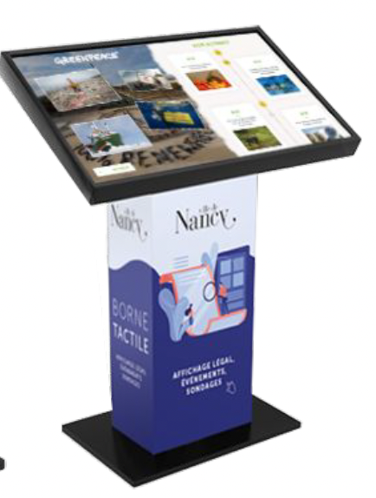
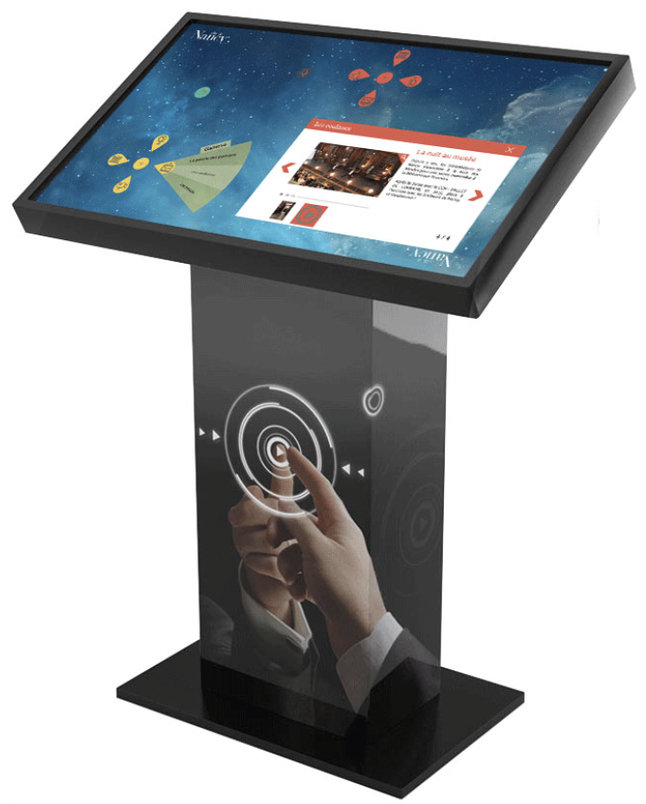
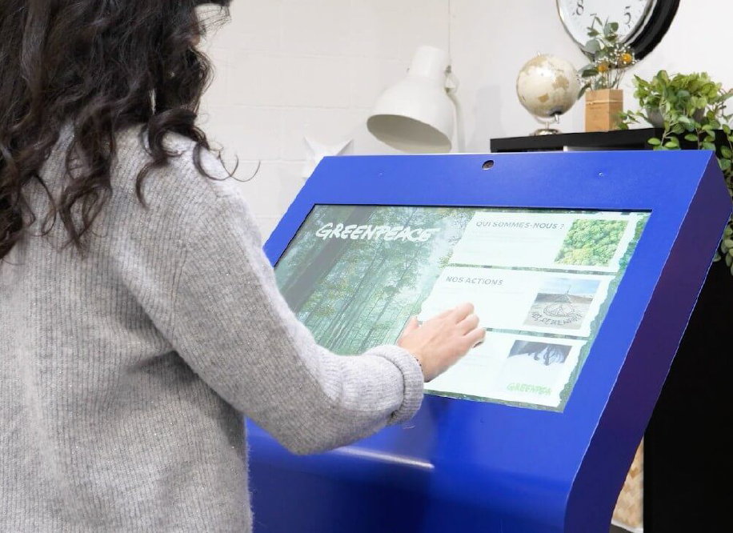
PRODUCTS
GORILLE WHITE-STATION
CONSOLE (USB or WEB DRAG-DROP)
  [SERVER] [ISOLATATED]
CONSOLE (USB or WEB DRAG-DROP)
  [SERVER] [SEGMENTED NETWORK]
CONSOLE (USB or WEB DRAG-DROP)
  [SERVER] [ON-PREMISE]
CONSOLE (USB or WEB DRAG-DROP)
  [SERVER] [CLOUD]
Notes:
The end-user may choose specific security steps : segmented network, isolated console, update, etc.

Slide 33
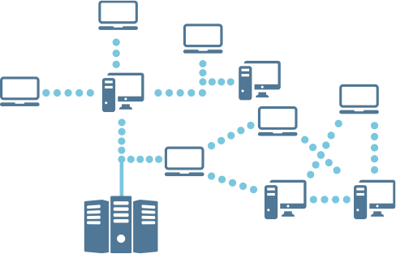
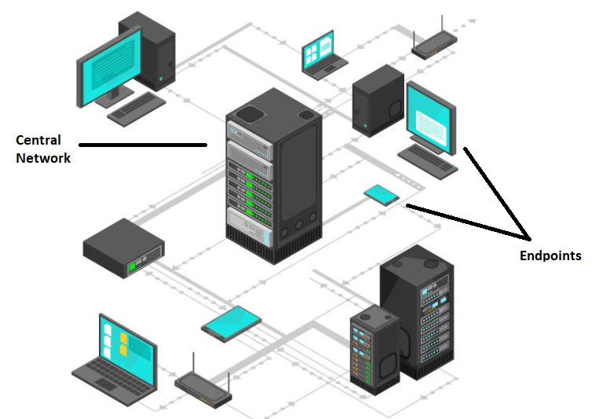
PRODUCTS
GORILLE API FOR xDR PLATFORM
CHARACTERIZATION OF MALWARE
  [SERVER] [REST API] [ON-PREMISE]
CHARACTERIZATION OF MALWARE
  [SERVER] [REST API] [CLOUD]
CHARACTERIZATION OF MALWARE
  [SERVER] [REST API] [CUSTOMIZED UPDATE]
# Upload file curl --request POST \
--url https://demo.gorille.tech:4433/api/v1/files \
--header 'x-apikey: w6b8ly7oiktxxxxxxxxxptr882qwtgxbpawpndweglz1hlh5kv' \
--form file=@/Users/JYM/Programming/cyber-detect/FTP/samples/VIRUScX7hQTy7Py.EMOTET.bin
# Get analysis curl --request GET \
--url https://demo.gorille.tech:4433/api/v1/files/{3c889d95e7a9398782bddc86157466bc} \
--header 'x-apikey: w6b8ly7oxxxxxxxxxxxxxxxxxxxxpawpndweglz1hlh5kv’ \
Notes:
The end-user may choose security steps : segmented network, isolated console, update, etc.
API example:
# Upload file curl --request POST \
--url https://demo.gorille.tech:4433/api/v1/files \
--header 'x-apikey: w6b8ly7oiktxxxxxxxxxptr882qwtgxbpawpndweglz1hlh5kv' \
--form file=@/Users/JYM/Programming/cyber-detect/FTP/samples/VIRUScX7hQTy7Py.EMOTET.bin
# Get analysis curl --request GET \
--url https://demo.gorille.tech:4433/api/v1/files/{3c889d95e7a9398782bddc86157466bc} \
--header 'x-apikey: w6b8ly7oxxxxxxxxxxxxxxxxxxxxpawpndweglz1hlh5kv’ \

Slide 34
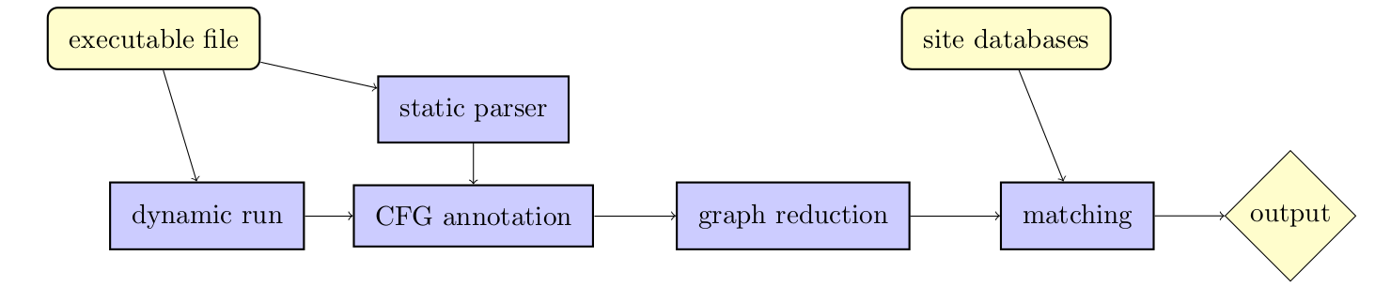
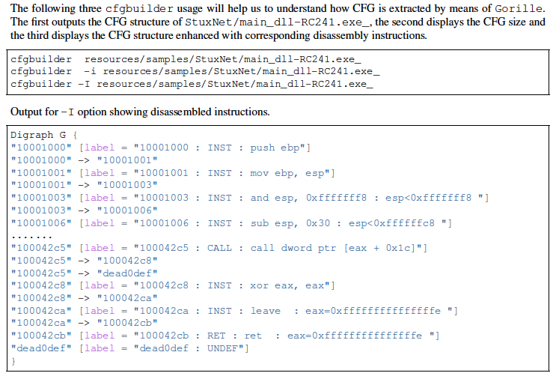
PRODUCTS
GORILLE EXPERT
CREATE DEDICATED WHITE DATABASE
  [DESKTOP] [COMMAND-LINE]
CUSTOMIZED SCRIPTS
  [DESKTOP] [COMMAND-LINE]
FAMILY ANALYSIS
  [DESKTOP] [COMMAND-LINE]
BINARY COMPARISON ANALYSIS
  [DESKTOP] [COMMAND-LINE]
Notes:
Without reverse engineering :
Family analysis. For example, building automation of 50 families from 100.000 files
Comparison of 2 binaries to find out similarities
“Belongs to Family” process. It help the attribution process and investigation

Slide 35
PRODUCTS
GORILLE SCAN-CLEANER
CLEANING OF INFECTED ENDPOINTS
  [SERVER] [REST API] [ON-PREMISE]
CLEANING OF INFECTED ENDPOINTS
  [SERVER] [REST API] [CLOUD]
CLEANING OF INFECTED ENDPOINTS
  [SERVER] [REST API] [CUSTOMIZED SETTINGS]
PREVENTION FROM NEW ATTACKS
  [SERVER] [AGENTS SCHEDULE PROCESS AUTOMATION]
Notes:
Gorille receives a request (rest api) from the EDR and delivers the responds for automation (orchestrator)

Slide 36
BENCHMARK
DATABASE AND ATTACKS
T0
T1
NEW_ATTACK (VARIANT)
T2
T3
GOD VIEW
WHITE_BLACK_DATABASE_AV_SIG
NO DETECTION
NOTHING UNTIL DAMAGE
WHITE_ BLACK_ DATABASE_AV_AI
NO DETECTION
INDICE WITHOUT CONFIRMATION
EPP VIEW
WHITE_ BLACK_ DATABASE_AV_SIG
WHITE_ BLACK_ DATABASE_AV_AI
xDR ENGINE: DETECTION as SUSPICIOUS
IoC search
HIGH OVERHEAD REMEDIATION
WHITE_ BLACK_ DATABSE_XDR
xDR VIEW
WHITE_ BLACK_ DATABASE_AV_SIG
WHITE_ BLACK_ DATABASE_AV_AI
(1)
(2)
WHITE_ BLACK_ DATABASE_XDR
(3)
WHITE_ BLACK_ DATABASE_GORILLE
MALWARE CHARACTERIZATION
ATTACK CHARACTERIZATION
QUICK & CONSISTANT REMIDIATION
GORILLE VIEW
WHITE_ BLACK_ DATABSE_THIRDPARTY
(4)
Notes:
(1) White-Database cannot be exhaustive, since this contradicts the principe of undecidability if a binary is or not a virus.
(2) When classic database are not anymore useful, on can rely on Gorille based upon a efficient engine (morphological). The game changer Gorille uses morphological engine. The engine is used in addition to AV
(3) The global network brings daily unkown malware (variant) and unknow file (new software, new files updates from supplier or third editors). Cyber-Detect can help editor or integrator to analyze new file before installation (patch, news version). Editors cannot rely on a magical antivirus database
(4) Files from editor, integrator. New installation, updates

Slide 37
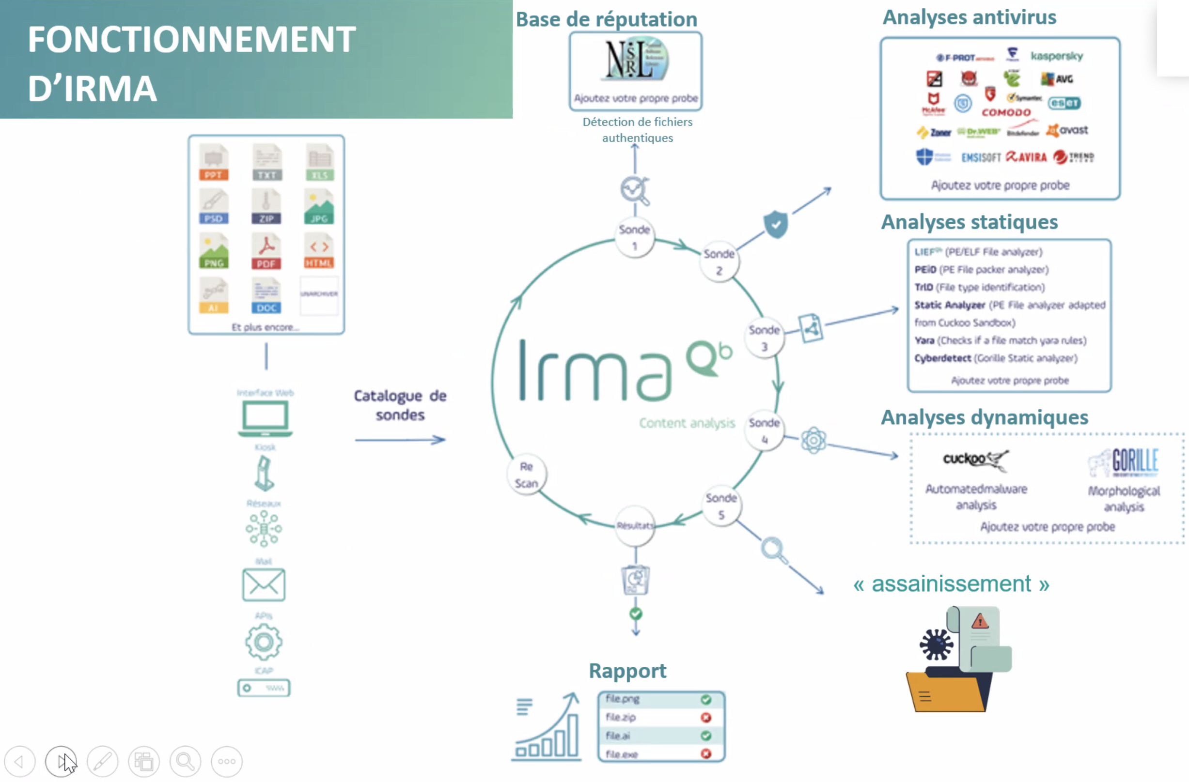
QUARKSFLOW
WHITE_ BLACK_ DATABASE_AV_SIG
WHITE_ BLACK_ DATABASE_AV_AI
WHITE_ BLACK_ DATABSE_XDR
WHITE_ BLACK_ DATABASE_EDITOR
(first installation, updates, patch)
(1)
WHITE_ BLACK_ DATABASE_GORILLE
MORPHOLOGICAL
ENGINE
(2)
(1) Gorille helps editors, suppliers and integrators to build white-black database
(2) The morphological engine will be used to bypass classic database limitation

Slide 38

www.cyber-detect.com
www.psc-france.com

